Slide 1
CMOS Layers
n-well process
p-well process
Twin-tub process

Slide 2
n-well process
Gate
NMOS
NMOS
PMOS
PMOS
FOX
p-substrate
n+
n+
n+
n+
p+
p+
p+
p+
n-well
MOSFET Layers in an n-well process

Slide 3
Layer Types
p-substrate
n-well
n+
p+
Gate oxide
Gate (polycilicon)
Field Oxide
Insulated glass
Provide electrical isolation

Slide 4
Top view of the FET pattern
NMOS
NMOS
PMOS
PMOS
n+
n+
n+
n+
p+
p+
p+
p+
n-well

Slide 5
Metal Interconnect Layers
Metal layers are electrically isolated from each other
Electrical contact between adjacent conducting layers requires contact cuts and vias

Slide 6
Metal Interconnect Layers
Ox3
Via
Metal2
Active
contact
Ox2
Metal1
Ox1
p-substrate
n+
n+
n+
n+

Slide 7
Interconnect Layout Example
Gate contact
Metal1
Metal2
Metal1
MOS
Active contact

Slide 8
Designing MOS Arrays
A
B
C
x
y
A
B
C
y
x

Slide 9
Parallel Connected MOS Patterning
x
x
A
B
A
B
X
X
X
y
y

Slide 10
Alternate Layout Strategy
x
x
X
X
A
B
A
B
X
X
y
y

Slide 11
Basic Gate Design
Both the power supply and ground are routed using the Metal layer
n+ and p+ regions are denoted using the same fill pattern. The only difference is the n-well
Contacts are needed from Metal to n+ or p+

Slide 12
The CMOS NOT Gate
Contact Cut
Vp
Vp
X
n-well
X
X
X
Gnd
Gnd

Slide 13
Alternate Layout of NOT Gate
Vp
Vp
X
X
X
X
Gnd
Gnd

Slide 14
NAND2 Layout
Vp
Vp
X
X
X
Gnd
X
X
Gnd

Slide 15
NOR2 Layout
Vp
Vp
X
X
Gnd
X
X
X
Gnd

Slide 16
NAND2-NOR2 Comparison
Vp
X
X
X
X
X
Gnd
Vp
X
X
MOS Layout
X
Wiring
X
X
Gnd

Slide 17
General Layout Geometry
Vp
Shared drain/
source
Individual
Transistors
Shared Gates
Gnd

Slide 18
Graph Theory: Euler Path
Vp
x
Vertex
b
c
x
Edge
a
Out
y
y
c
Vertex
a
b
Gnd

Slide 19
Stick Diagram

Slide 20
Stick Diagrams
Cartoon of a layout.
Shows all components.
Does not show exact placement, transistor sizes, wire lengths, wire widths, boundaries, or any other form of compliance with layout or design rules.
Useful for interconnect visualization, preliminary layout layout compaction, power/ground routing, etc.

Slide 21
Stick Diagrams
Metal
poly
ndiff
pdiff
Can also draw
in shades of
gray/line style.

Slide 22
Stick Diagrams
Buried Contact
Contact Cut

Slide 23
5 V
Dep
V_{out}
Enh
0V
5 v
5 v
V_{in}
V_{in}
0 V

Slide 24
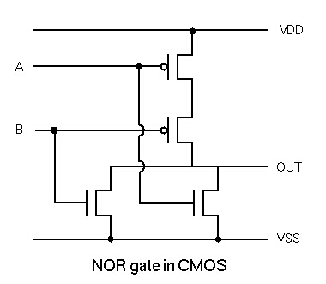
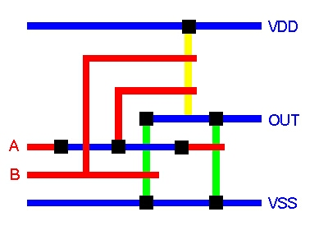
Stick Diagram - Example I
A
OUT
B
NOR Gate

Slide 25
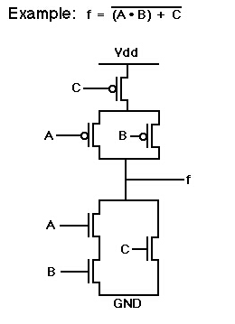
Stick Diagram - Example II
Power
A
Out
C
B
Ground

Slide 26
Points to Ponder
be creative with layouts
sketch designs first
minimize junctions but avoid long poly runs
have a floor plan plan for input, output, power and ground locations

Slide 27
The End

